Slide 1

Cleanup Committee Meeting
Ideas, Suggestions, and Input from Geoffrey M. Latham – Visual Arts Instructor at Coahoma County Agricultural High School

Slide 2
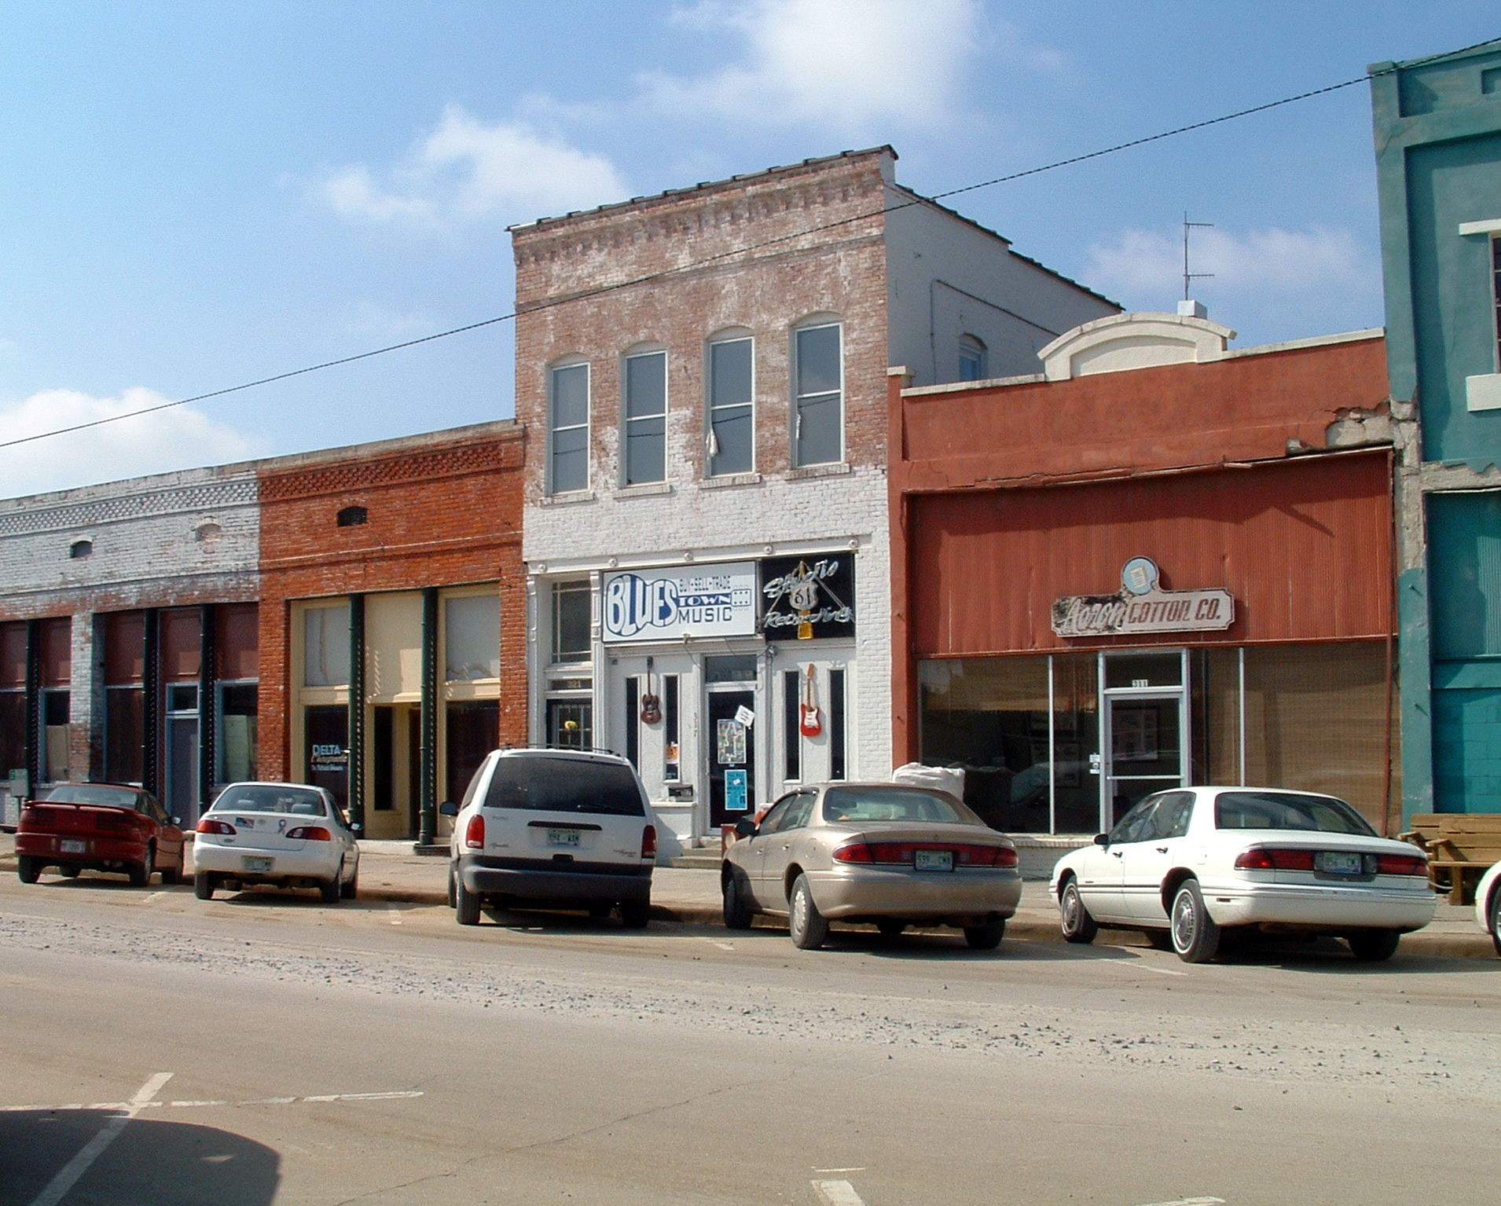
April is Cleanup Month
INITIAL IDEA
Students paint paper pictures to hand in the windows of abandoned stores downtown.
Wonderful Idea!!!

Slide 3
Some Things To Consider…
Paper thick and sturdy enough for painting can be costly
Paper is fragile medium unless cared for and displayed properly
Typical paper paintings will likely be relatively small in format compared to the display space which means intricate details may be lost to viewers that aren’t in close proximity to the artwork

Slide 4
Some ways to work around those issues
Use Brown Craft Paper that is less likely to wrinkle and provides for large scale images.
Use heavy weight all media paper for painting and have all work accompanied by large print Artist labels.
Include “dry media” artwork such as pencil, crayon, color pencil, or charcoal works.

Slide 5
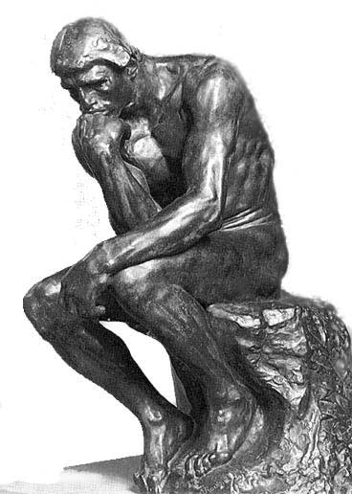
After hearing the initial Idea, I got to thinking…
What are some other ways that the young artists of the community can help beautify the area?

Slide 6
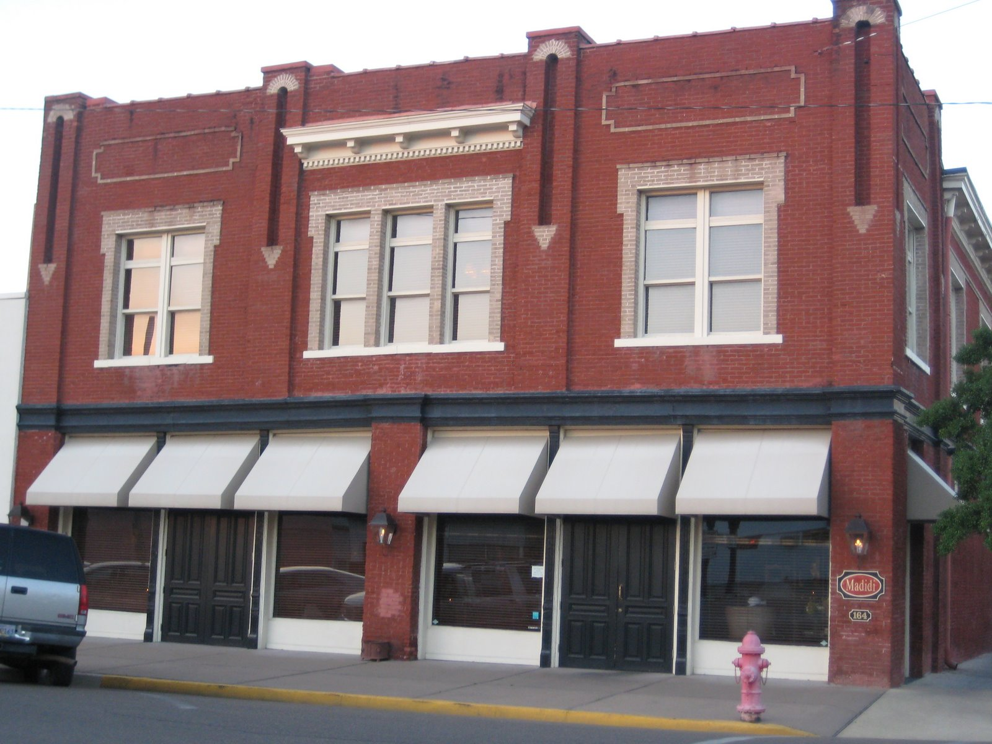
I had some ideas that I would like to share with you.
Murals on the sides of buildings or on the interior glass of the store windows themselves would be an excellent large scale medium for young artists to work on.
While large scale artwork of this nature would require permission from the property owners and funding for materials, they would provide the kind of local artistic imagery that can become iconic of a community as well as a source of civic pride.

Slide 7
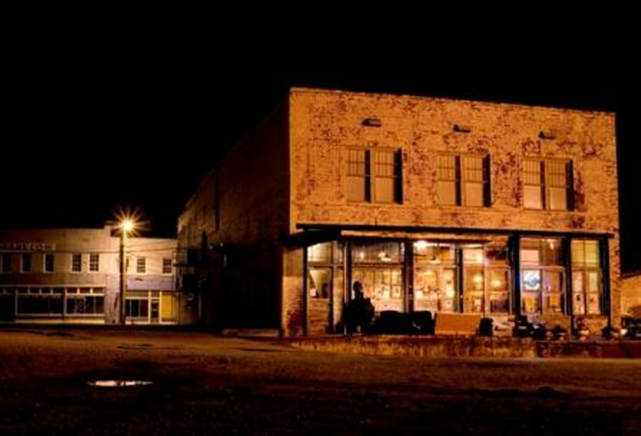
Since you’re going to use the buildings anyway…
Hanging images in the window is great for a short term display.
Murals are an excellent choice for permanent or semi-permanent artwork.
But, if you are going to use the buildings to feature student artwork, why not seek to use the buildings as a sort of public gallery for the community, as well?

Slide 8
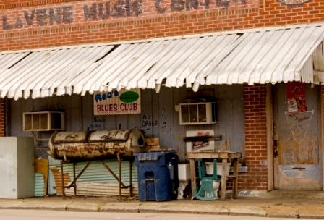
Since you’re going to use the buildings anyway…
These abandoned buildings could be uses inside and out to showcase the creative efforts of the community’s youth and provide a means for greater artistic growth among citizens, as well as serve as a valuable resource for encouraging tourism and a hub of disseminating information about the community, its people, and its businesses.
Building owners could even be given local tax incentives for letting the city/county/ chamber of commerce make use of these structures for civic art exhibits and or community events!

Slide 9
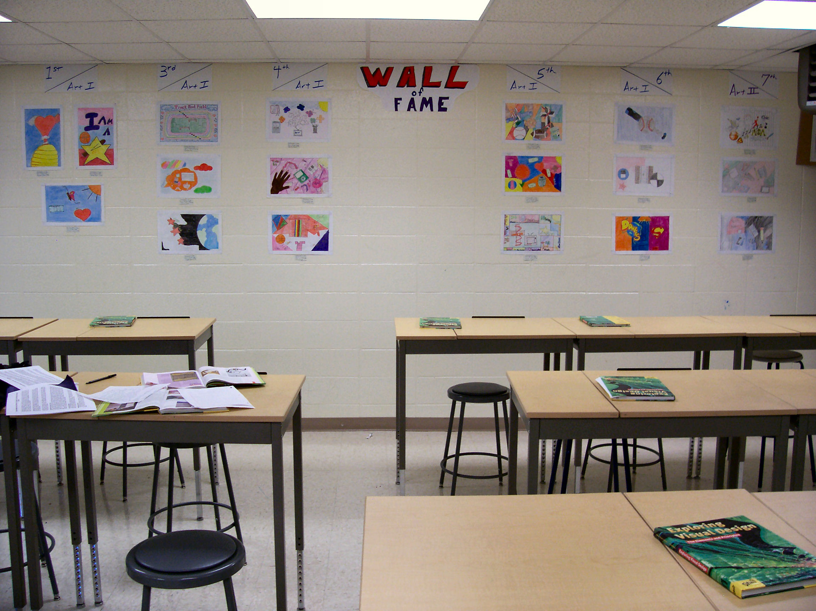
In addition to two dimensional work…
Sculptural projects could also be used as a means to beautify the area and serve as a symbol of community pride and dedication to the unique culture of the Mississippi Delta.

Slide 10
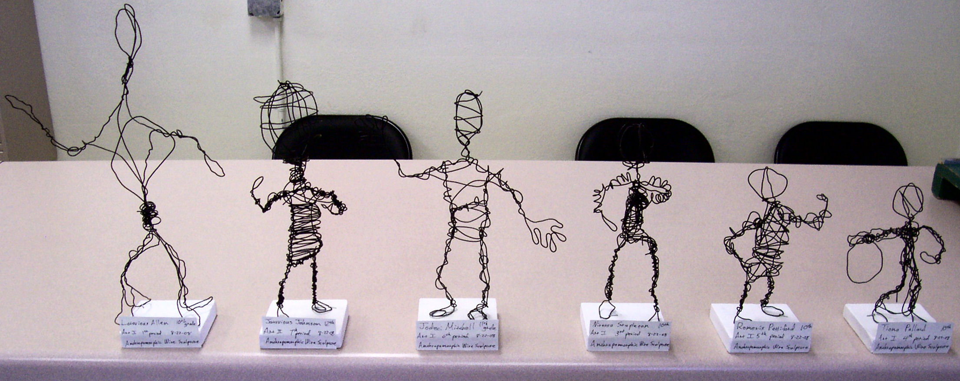
Sculptural Art Ideas…
Trash Assemblage Art
Assemblage art- a form of sculpture comprised of "found" objects arranged in such a way that they create a piece. These objects can be anything organic or man-made. Scraps of wood, stones, old shoes, baked bean cans and a discarded baby buggy are all examples of things that can be used to make assemblage art.
Trash can be collected and sorted by trustees or persons doing community service so that durable materials such as hard plastic, rubber, wood, metal, etc. can be used for the creation of assemblage sculptures which could be showcased in or nearby abandoned structures or even local parks.
Here are some examples….

Slide 11
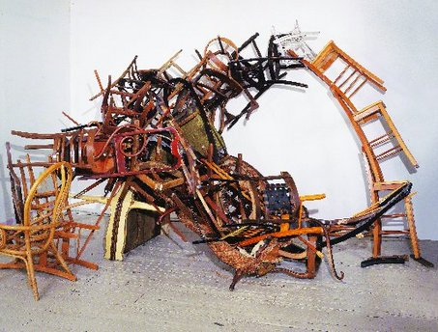
sculpture made from wooden thrift-shop chairs by Marc Andre Robinson

Slide 12
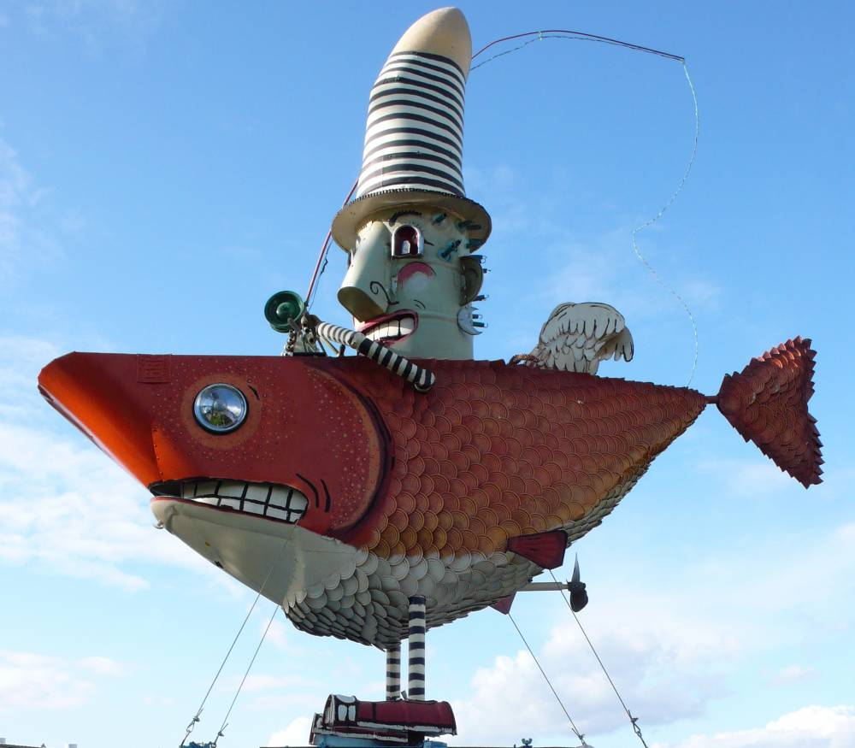
Assemblage sculpture by artist Patrick Amiot of Sebastopol California

Slide 13
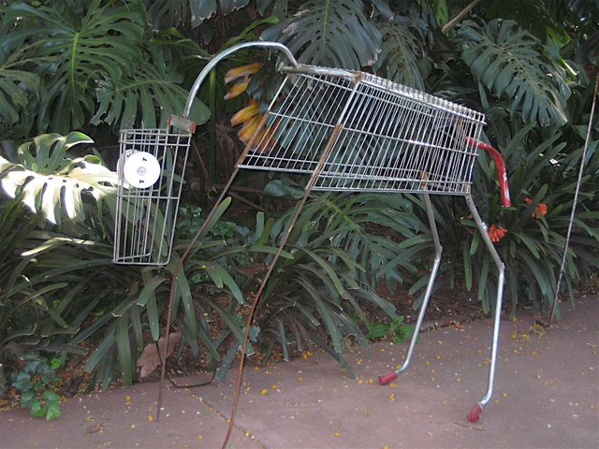
Recycled trash sculpture artist unknown

Slide 14
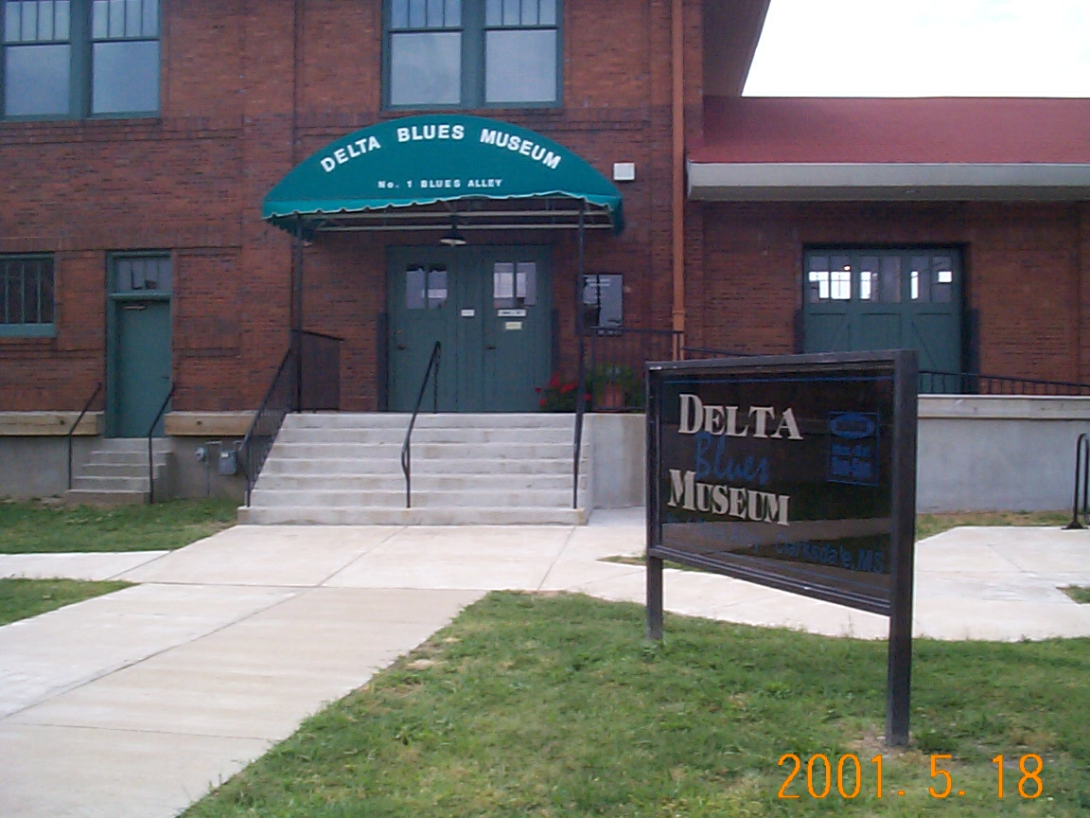
Another sculptural idea…
A city/County Icon Much like Meridian’s Carousel horses or Jackson’s Catfish on Parade could add lively artistic flavor to local areas of interest or provide a bohemian touch to areas that are otherwise lacking in cultural flair.
A theme animal or icon of some kind could be adopted, perhaps a blues guitar like those used in the Hwy 61/hwy 49 crossroads sign. Donations for the materials for the guitars could be solicited from local merchants such as furniture supply, hardware, and lumber stores and the materials distributed to visual art instructors throughout the county for students to create their own unique piece of work that could be displayed downtown or around the area at local landmarks.

Slide 15
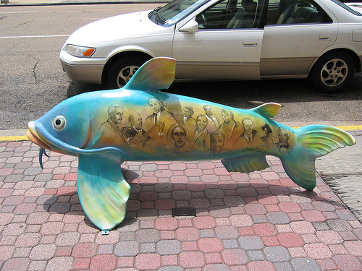
Famous Mississippians Catfish

Slide 16
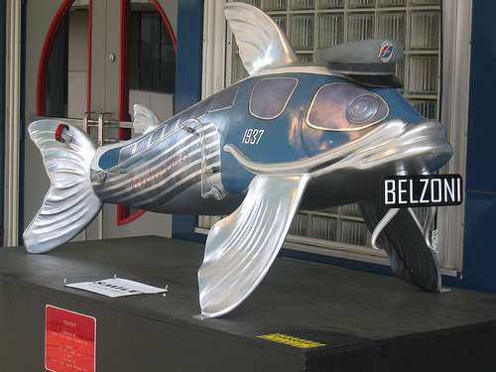
Greyhound Catfish

Slide 17
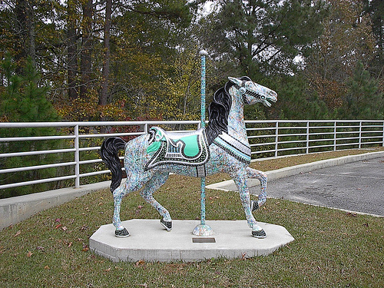
Carousel Horse, Meridian MS

Slide 18
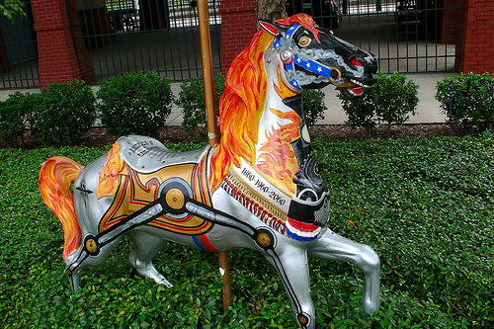
Around Meridian Carousels Abound is an outdoor public art project. The carousel horses are sponsored and placed at over 50 locations around Meridian. This one is located at the train station and features a rail spike in the horses mouth.

Slide 19
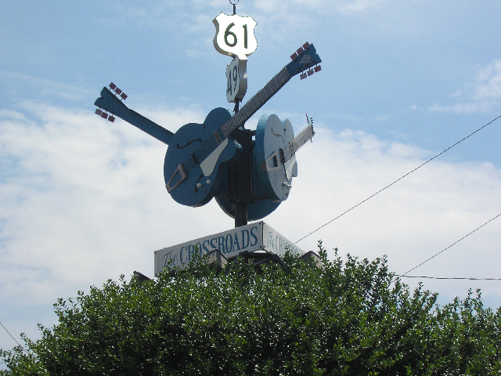
In Conclusion…
I hope that my input has helped provide you with fuel for discussion and a means to help improve the community that my students share.
Thank you for your Time and Attention!

